Slide 1

Starbucks - Web and Social Analysis MSBA 324 & MKT 324 Final Project
Submitted By:
Puneeth Kumar Gowda Chandra, Megha Sehgal, Nishchal Krishnappa, G Vijay Kumar
Date: April 2024

Slide 2
Table of Contents
Introduction to Starbucks (M)
Problem Statement (V)
Sentiment Analysis (N)
Sentiment comparison (P)
Sentiment Analysis Results (N,P)
Comparative Insights and Recommendations (V)
Key Sentiment Insights (P)
Common Words in Sentiment Analysis (N)
Social Media Handling and Traffic Data (V)
Strategy Recommendations (P,V,N)
Traffic and Engagement Data (P)
Related Search Trends in the USA (M)
Conclusion (V)
Recommendations (P,V,N,M)
References
Notes:
Puneeth Kumar Gowda Chandra, (P) Megha Sehgal, (M) Nishchal Krishnappa, (N) G Vijay Kumar (V)

Slide 3
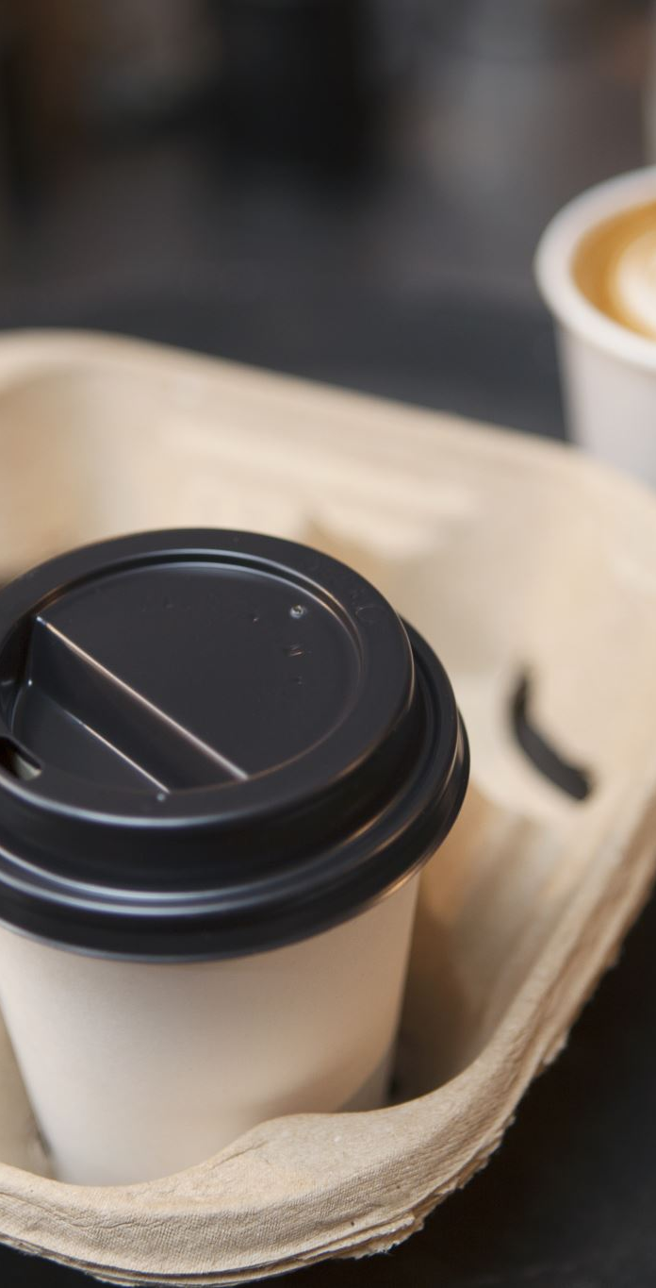
Introduction to Starbucks
Founded in 1971, Starbucks has grown from a small coffee shop in Seattle’s Pike Place Market to a global chain with over 30,000 locations in more than 70 countries.
Offers premium Arabica coffee and more, expanding menu to meet consumer tastes.
Demonstrates remarkable adaptability to consumer preferences, continuously evolving its product offerings to meet changing consumer needs.
Known for community commitment and high environmental standards.
Upholds a strong culture of innovation and community involvement, building robust relationships with employees and customers, all aligned with its mission to "inspire and nurture the human spirit."

Slide 4
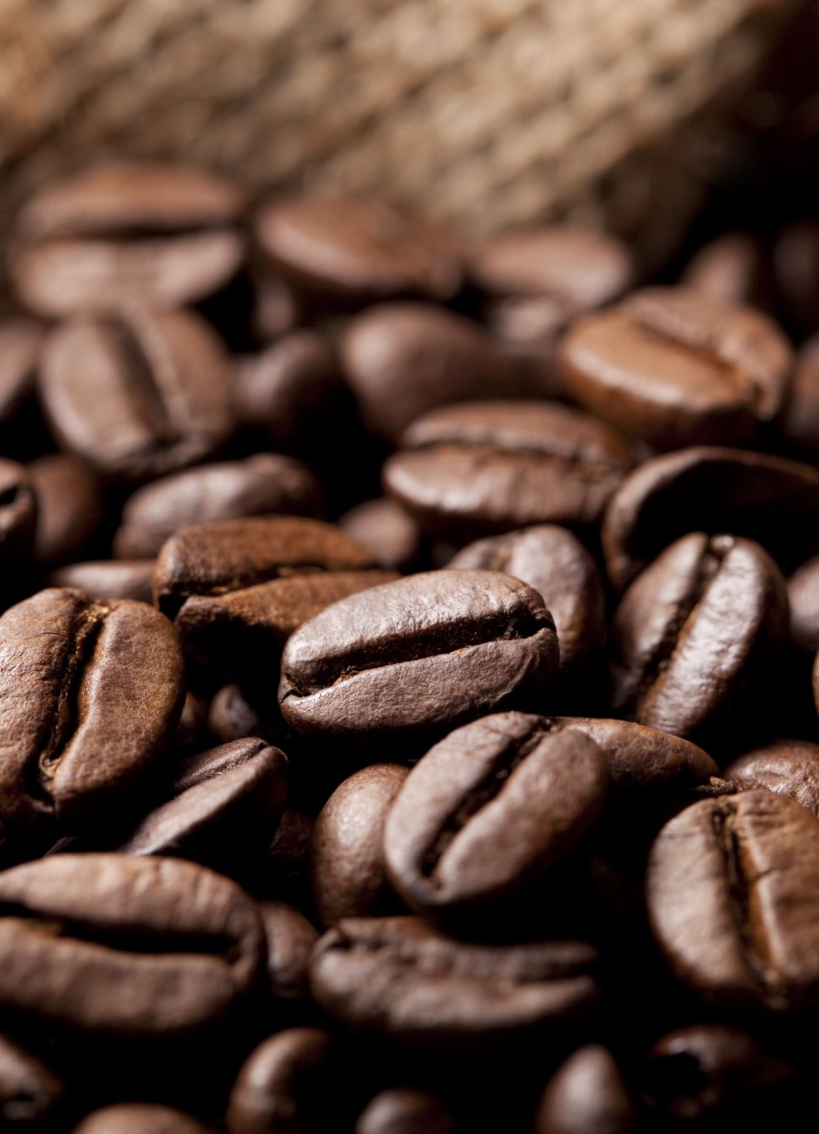
Problem Statement
Market Position: Concerns about Starbucks not being the market leader in certain demographic categories as shown by sales data.
Generational Misalignment: Potential misalignment between Starbucks' brand or products and the preferences or values of different generational cohorts.
Brand Perception: Challenges in how specific age groups perceive the brand's offerings and marketing strategies.
Market Potential: Risk of not fully capturing market potential within certain demographic segments, impacting overall growth and reach.

Slide 5
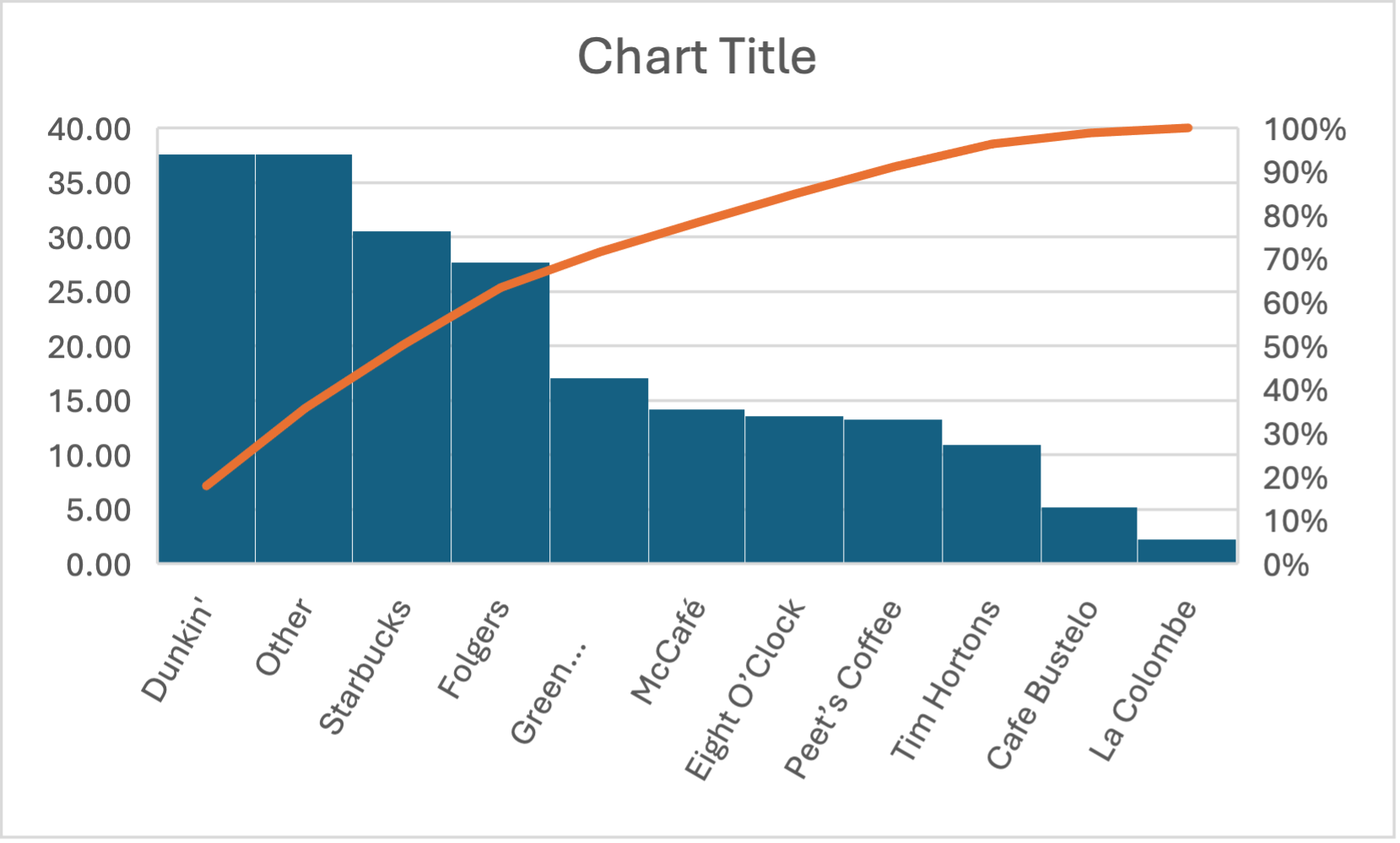
This chart suggests Starbucks has a significant market presence, but it is not leading in the depicted category.

Slide 6
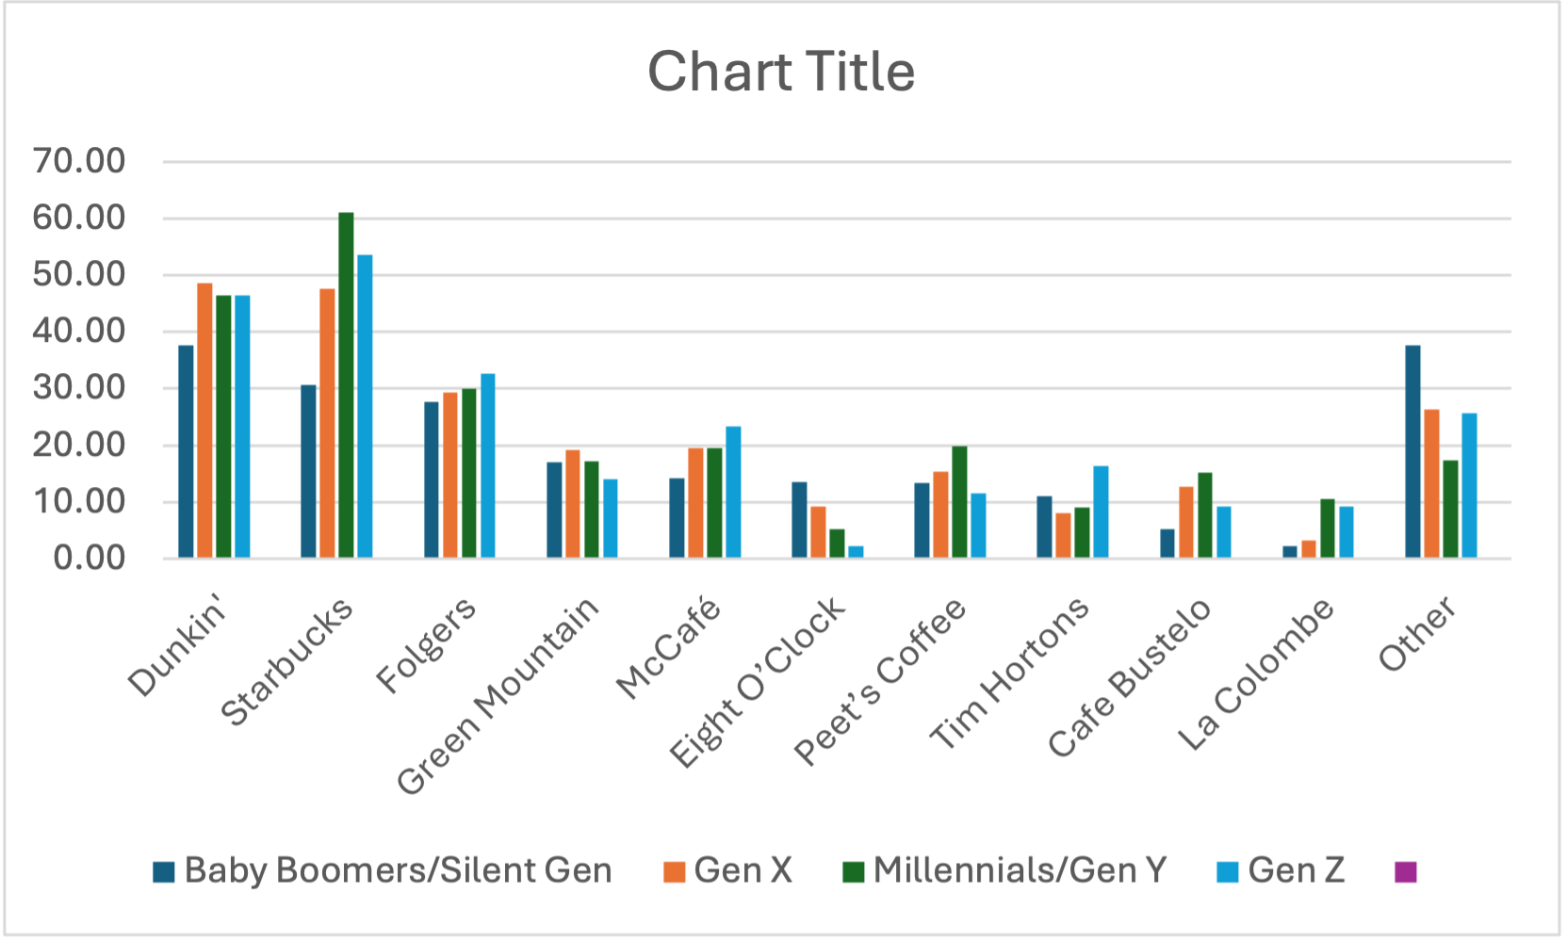
Here, the chart indicates varying preferences across different generations, with notable gaps in appeal to certain age groups.

Slide 7
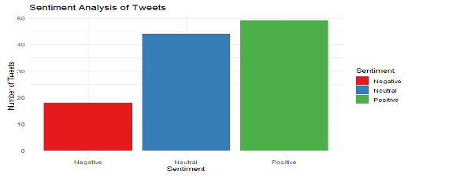
Sentiment Analysis
Starbucks enjoys a favorable brand sentiment with strong customer affinity evident from social media and MP4 data.
Identified key themes and emotional responses to the brand across demographics.
Despite the positivity, there's room to elevate perceptions, particularly by transforming any negative feedback into enhanced engagement opportunities and further reinforcing the trust factor.

Slide 8
Sentiment comparison
Overview of Sentiment Analysis
Purpose: Compare customer sentiment across Starbucks, Peet's Coffee, and Dunkin' Donuts using social media and website data.
Methodology: Analysis conducted through natural language processing of online reviews, social media posts, and customer feedback.

Slide 9
Sentiment Analysis Results
Starbucks: Dominantly positive sentiment with strong associations of trust and luxury, indicating high customer loyalty. It also leads in website traffic, indicating successful conversion of social media activities to customer visits
Peet's Coffee: Generally favorable but less pronounced than Starbucks. Lags behind in social media presence, suggesting room for significant growth
Dunkin' Donuts: Shows more balanced sentiment profile with a solid base of regular customers, showing potential for growth through targeted marketing and new product introductions.

Slide 10
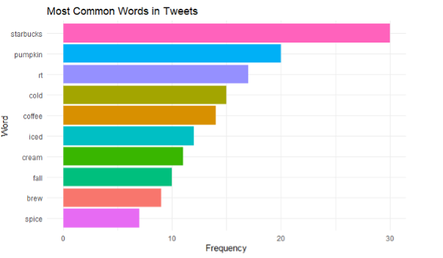
Comparative Insights and Recommendations
Comparative Strengths: Starbucks leads in positive sentiment and brand trust; Dunkin' Donuts shows versatility across different platforms; Peet's Coffee has a dedicated niche that could be expanded.
Recommendations:
Starbucks: Continue leveraging strong brand loyalty and trust to introduce innovative products.
Peet's Coffee: Increase social media presence and engage with younger demographics through targeted campaigns.
Dunkin' Donuts: Utilize balanced sentiment to strengthen customer relationships and explore visual content strategies on platforms like Instagram.

Slide 11

Key Sentiment Insights
The key sentiment insights suggest that customers hold a largely positive view of Starbucks, with trust and reliability being significant factors.
To build on this, Starbucks could engage directly with customers to address any negative sentiments.
Strategies to bolster engagement include transparent communication, ensuring consistent product quality, and crafting exciting marketing campaigns to foster anticipation and joy.
This approach could transform neutral or negative views into positive customer experiences and loyalty.

Slide 12
Common Words in Sentiment Analysis
Dominant themes in customer feedback
The sentiment analysis reveals "coffee" as the dominant theme in customer feedback, signaling the core of Starbucks' product line.
Popularity of seasonal offerings
Words like "pumpkin" highlight the popularity of seasonal offerings, suggesting that these limited-time products successfully attract and engage customers, creating a buzz and driving positive sentiment around the brand.

Slide 13
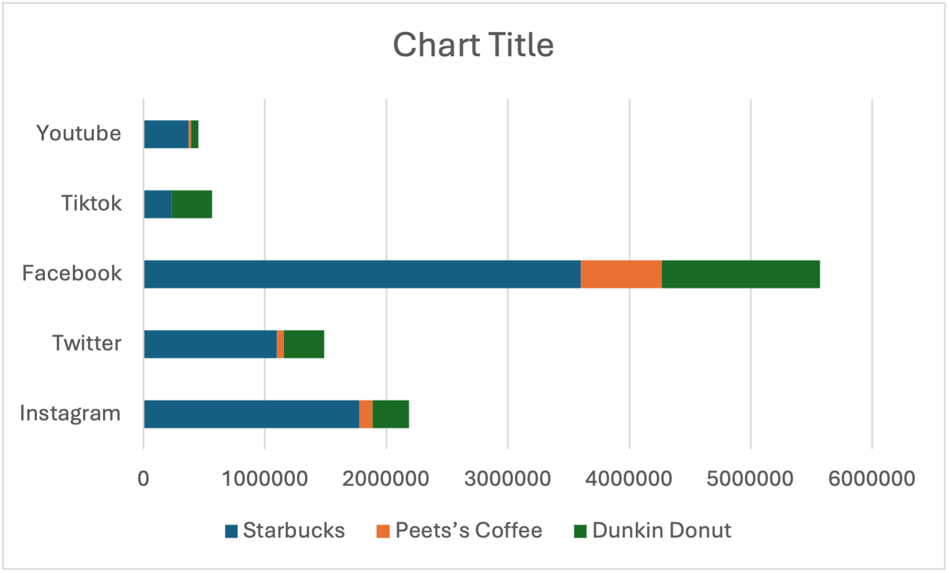
Social Media Handling and Traffic Data
Starbucks exhibits a commanding digital presence, particularly on visual platforms like Instagram and Facebook, indicating a successful visual strategy.
The brand's social media strategies are competitive, fostering high engagement and translating into significant web traffic.
Analytics suggest a well-integrated approach that leverages social media activity to drive customer visits to Starbucks' website.
Starbucks sets an industry benchmark in utilizing social media for customer engagement and online conversions.

Slide 14

Strategy Recommendations
Enhance customer service to convert negative sentiments to positive.
Maintain transparency to bolster trust.
Introduce exciting campaigns and product innovations.

Slide 15

Traffic and Engagement Data
Starbucks dominates with over 61 million website visits, indicating strong digital engagement.
The brand maintains high and consistent online interest, suggesting effective marketing and customer retention strategies.
Starbucks' digital approach successfully drives online traffic, reflecting in its superior web presence compared to competitors.

Slide 16
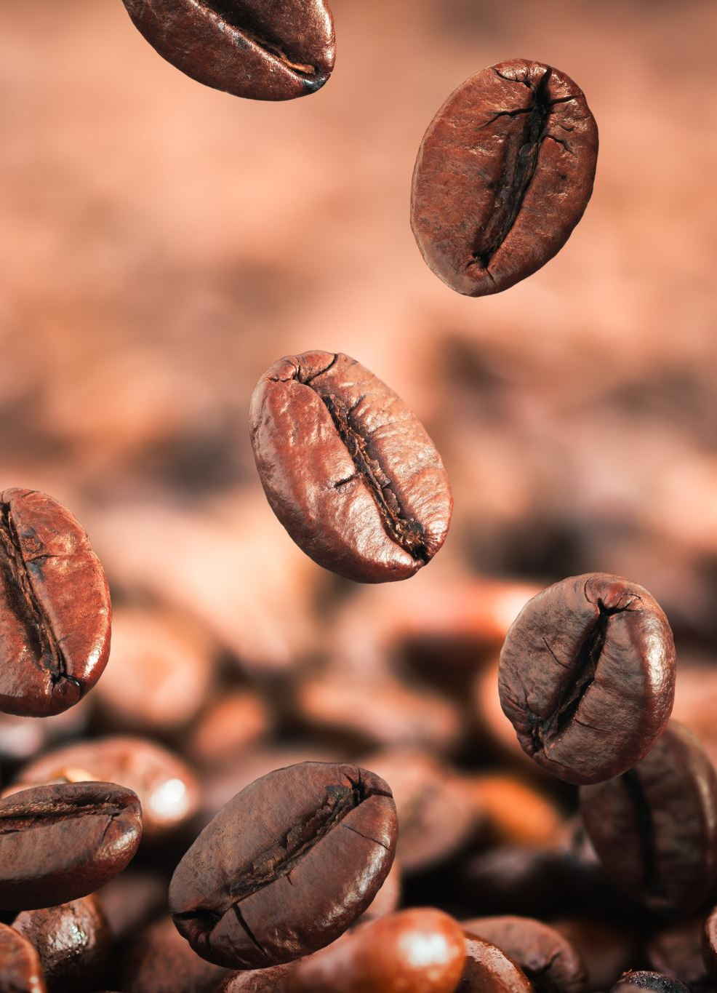
Related Search Trends in the USA
The search trends data highlight Starbucks’ prominent visibility and popularity within the US market.
Trends suggest that Starbucks is frequently associated with related searches, indicating strong brand recognition.
The data may also reflect effective SEO practices by Starbucks, ensuring high visibility in related online searches.

Slide 17

Conclusion
Starbucks has demonstrated significant strength in market share, bolstered by an effective digital strategy and broad brand popularity.
The company has effectively utilized its social media platforms and website to engage customers, drive traffic, and facilitate conversions, setting a high industry standard.
Summary of Strengths:
Market Share: Starbucks continues to dominate the coffee industry with a substantial market share, reflective of its extensive global footprint and strong customer base.
Digital Strategy: The company excels in digital engagement, utilizing platforms like Instagram and Facebook to maintain high visibility and customer interaction.
Brand Popularity: Starbucks remains a highly recognized and respected brand, synonymous with quality and innovation, which appeals to a wide range of consumers.

Slide 18
Recommendations
To boost sales and appeal across diverse generations, Starbucks should tailor their approach with the following strategies:
For Gen Z: Capitalize on digital platforms by partnering with influencers and creating viral social media challenges. Introduce sustainable practices and products to resonate with their environmental consciousness. Gen Z values authenticity, so Starbucks should highlight the brand's ethical sourcing and community initiatives.
For Millennials: Continue with loyalty programs that offer personalized rewards. Plan limited-time retail events and promotions for millennials who prefer to experience new things. Make shopping and paying simpler for tech-savvy, on-the-go customers by improving the mobile app.
For Gen X: To appeal to Gen X's realistic side, focus on quality and dependability. Provide a comfortable in-store experience for this demographic, who may value a peaceful environment to work or relax. Offer premium products and services that cater to their willingness to pay for added value.
For Baby Boomers: Provide excellent customer service and a community feel within stores. Baby Boomers may appreciate traditional marketing techniques, such as direct mail coupons or community boards highlighting local events and offerings.
Across all generations, diversify product offerings with healthy options and expand plant-based alternatives. Keep adding new regional and international tastes to the menu. Spend money on teaching your staff to give better customer service and make the store experience better overall. Environmentally conscious and ethical brands are popular nowadays.
Starbucks can draw more customers, increase sales across all generations, and beat the competition by concentrating on personalized experiences, leveraging technology to simplify things, and following ethical and sustainable business practices.

Slide 19
References
Analytics, G. (n.d.). How Does Consumer Foot Traffic to Starbucks Compare to its Competitors?
Gravy Analytics. Retrieved from https://gravyanalytics.com/blog/how-does-consumer-
foot-traffic-starbucks-compare-to-
competitors/#:~:text=Foot%20traffic%20to%20Starbucks%2C%20the,Dunkin'%20Donut
s%20saw%20a%20decrease.
Analytics, G. (July 25, 2023). What Starbucks Foot Traffic Tells Us About Current Coffee
Consumer Trends. Gravy Analytics. Retrieved from
https://gravyanalytics.com/blog/starbucks-foot-traffic-current-coffee-consumer-
trends/#:~:text=Starbucks%20experienced%20a%20fairly%20notable,declining%20sligh
tly%20in%20Q2%202023.
Cucu, E. (Jan 11, 2023). [Brand Analysis] Starbucks on Social Media - The Marketing Tactics
Behind the Brand’s Social Popularity. socialinsider. Retrieved from
https://www.socialinsider.io/blog/starbucks-social-media-strategy/
Johnson, D. O. (Mar 20, 2024). Peet's Coffee Vs Starbucks: a Comparative Analysis. gradesfixer.
Retrieved from https://gradesfixer.com/free-essay-examples/peets-coffee-vs-starbucks-a-
comparative-analysis/

Slide 20
Justt. (n.d.). How Starbucks builds customer relationships to improve bottom-line figures. June
12, 2023: retaildive. Retrieved from https://www.retaildive.com/spons/how-starbucks-
builds-customer-relationships-to-improve-bottom-line-figures/651999/
Statista. (February 2024). Which of the following brands of coffee are your favorite?
Statista.com. Retrieved from https://www.statista.com/statistics/1450633/favorite-coffee-
brands-among-us-consumers-by-
generation/#:~:text=According%20to%20a%20recent%20U.S.,Boomers%20seemed%20t
o%20prefer%20Dunkin'. (DATA)
Statista. (February 2024). Which of the following brands of coffee are your favorite?
Statista.com. Retrieved from https://www.statista.com/statistics/1327923/favorite-coffee-
brands-among-us-
consumers/#:~:text=According%20to%20a%20recent%20U.S.,of%20respondents'%20vo
tes%2C%20respectively.(DATA)
Technology, N. W. (May 30, 2023). Brewing a Buzz: A Starbucks Social Media Marketing Case
Study. Linkedin. Retrieved from https://www.linkedin.com/pulse/brewing-buzz-
starbucks-social-media-marketing-case
Twitter, Web scrapping for Starbucks,peet's.dunkin donut

Slide 21
THANK YOU

